Slide 1
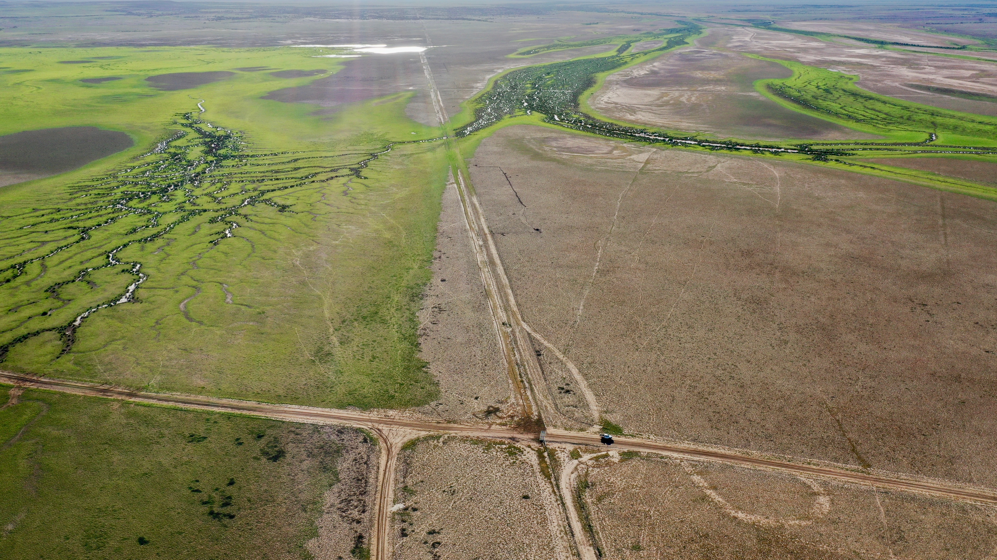

BENGAL ENERGY
ANNUAL GENERAL MEETING PRESENTATION
SEPTEMBER 29 2025

Slide 2
Forward-Looking Statements, Cautionary Statements and Oil & Gas Advisories
Certain information regarding Bengal Energy Ltd. ("Bengal" or the "Company") set forth in this document contains forward-looking statements or financial outlooks (collectively, "forward-looking statements") under applicable securities law. The use of any of the words "plan", "expect", "project", "intend", "believe", "should", "anticipate", "estimate" or other similar words, or statements that certain events or conditions "may" or "will" occur are typically intended to identify forward-looking statements. Forward-looking statements are not based on historical facts, but rather on Bengal's internal projections, estimates, beliefs, opinions, and assumptions at the time the statements were made concerning, among other things, the impact of economic conditions in North America and Australia and globally; industry conditions; changes in laws and regulations including, without limitation, the adoption of new environmental laws and regulations and changes, how they are interpreted and enforced, and how Bengal may be impacted by such; increased competition and the availability of business prospects and opportunities; the availability of qualified operating or management personnel; fluctuations in commodity prices, foreign exchange or interest rates; stock market volatility and fluctuation; results of exploration, testing and drilling activities, and the continued or anticipated performance of assets; and future growth, results of operations, production, future capital and other expenditures (including the amount, nature and sources of funding thereof). We believe the expectations reflected in those forward-looking statements are reasonable but, no assurances can be given that any of the events anticipated by the forward-looking statements will transpire or occur, or if any of them do so, what, if any, benefits Bengal will derive from them. As such, undue reliance should not be placed on forward-looking statements.
These statements are only predictions, not guarantees, and actual events or results may differ materially. In particular, forward-looking statements included in this document include, but are not limited to, statements with respect to: the Company's focus, plans, priorities and strategies; the Company's position in the business environment, particularly in the Australian business environment; the continued performance of the Cuisinier oil field and the future drilling plans of the Company in such area; the Company's anticipated growth and testing plans with respect to ATP 934 and the Wareena, Caracal, Ramses and Karnak wells, including, without limitation, the anticipated restarting of shut-in historical producer wells from the Permian Toolachee, stimulation of 53 API oil discovery in the Wyandra zone, testing of production capacity, addition of storage and load-out infrastructure, the anticipated gas development via pipeline and/or the Company's gas to bytes strategy with respect to the Ramses well, and the Company's plans to re-enter the existing Karnak well and potentially drill a twin well, and the expected benefits of such plans to the Company; the Company's plans to test Ramses gas, Karnak gas, Ramses shallow oil production potential, as well as to expand gas-fired Bitcoin projects onshore Australia; the Company's plans to drill exploration prospects at ATP 732 and ATP 934 and the expectation that the Company will be able to convert large resources into reserves and production; the ability of the Company to successfully apply for certain retention leases; the ability of the Company to commission a crypto mining prototype project; the Company's level of debt and the continuation of such and the Company's expected cash flow; and the ability of third parties to perform their obligations under contracts and the expected benefit of such contracts and performance to the Company; the continued stabilization and strengthening of crude oil pricing, natural gas usage and primary energy consumption and the ability of Australia to be well positioned in respect of such trends; Bengal's position in comparison to Canadian and Australian listed peers; the performance of future wells; and the estimates of resources, reserves and well recovery.
In addition, statements relating to "reserves" or "resources" are by their nature forward-looking statements, as they involve the implied assessment, based on certain estimates and assumptions that the resources described can be profitably produced in the future. With respect to forward-looking statements contained in this document, Bengal has made assumptions regarding: current and future commodity prices and royalty regimes; availability of skilled labour; timing and amount of capital expenditures; access to capital to fund the Company's exploration, testing and drilling programs; future exchange rates; the impact of increasing competition; conditions in general economic and financial markets; availability of drilling and related equipment; effects of regulation by governmental agencies; royalty rates; future operating and transportation costs; and other matters. Although the forward-looking statements contained in this document are based upon assumptions which management believes to be reasonable, the Company cannot assure investors that actual results will be consistent with these forward-looking statements.
Reserves
All references herein to reserves are derived from the report of GLJ dated June 12, 2025, evaluating the oil, natural gas liquids and natural gas reserves of the Company as at March 31, 2025.

Slide 3
Cautionary Statements (cont’d)
Future Oriented Financial Information
This document contains future oriented financial information ("FOFI") within the meaning of applicable securities laws. The FOFI has been prepared by Bengal's management to provide an outlook of the Company's activities and results. The FOFI has been prepared based on a number of assumptions including the assumptions with respect to the costs and expenditures to be incurred by the Company, capital equipment and operating costs, foreign exchange rates, taxation rates for the Company, general and administrative expenses and the prices to be paid for the Company's production. Management does not have firm commitments for all of the costs, expenditures, prices or other financial assumptions used to prepare the FOFI or assurance that such operating results will be achieved and, accordingly, the complete financial effects of all of those costs, expenditures, prices and operating results are not objectively determinable. The actual results of operations of the Company and the resulting financial results will likely vary from the amounts set forth in the analysis presented in this document, and such variation may be material. The Company and its management believe that the FOFI has been prepared on a reasonable basis, reflecting management's best estimates and judgments. However, because this information is highly subjective and subject to numerous risks, it should not be relied on as necessarily indicative of future results. Except as required by applicable securities laws, Bengal undertakes no obligation to update such FOFI and forward-looking statements and information.

Slide 4
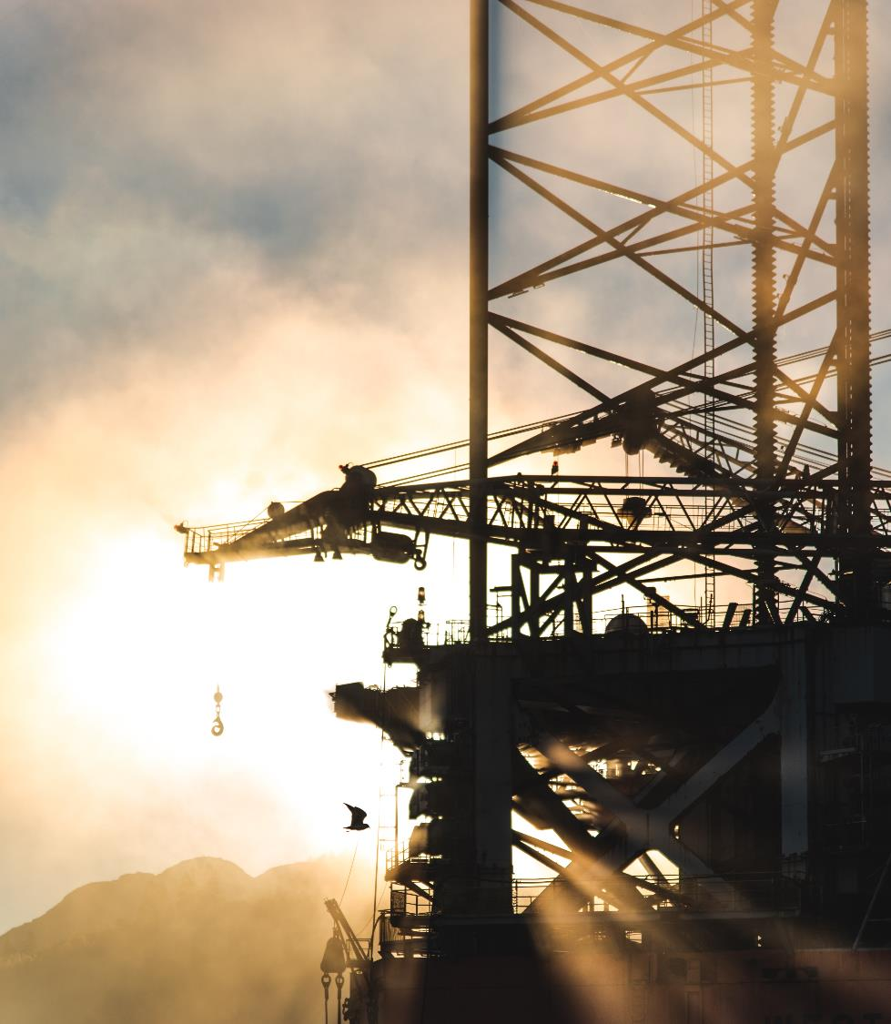
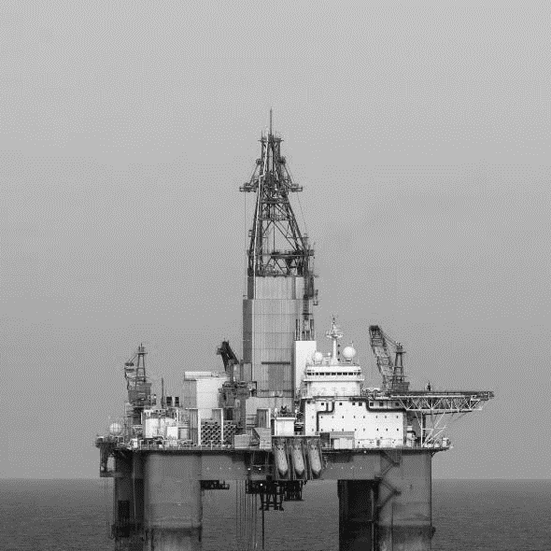
CORPORATE SNAPSHOT
CAPITAL STRUCTURE
Exploring and producing hydrocarbon assets in Australia for more than 15 years, Bengal Energy has a producing asset together with diverse operated growth opportunities and no debt. The Company has successfully demonstrated implementation of an innovative stranded and vented gas monetization technology, a first in Australia.
TSX code | BNG
TSX share price | C$0.01
Shares on issue | 485.3 million
Market capitalization | C$10 million
Debt | Nil
Free Op CF
Nil debt
Reserves Value (March 31, 2025)
2P NPV10 B. Tax $42.6 million, $0.09/share (basic)

Slide 5
Non-Executive Board members
Experienced and Committed Industry Experts
Dr. Brian Moss, Ph.D. (Geol)
Chairman of the Board
Brian Moss has more than 25 years of international exploration and development experience in the oil and gas industry in both private and public companies. Director of Crown Point Energy Inc. and former President and Chief Executive Officer of (formerly Crown Point Ventures Ltd.) a public oil and gas company from November 9, 2016, to March 1, 2022. Executive Vice President and Chief Operating Officer of Crown Point Energy Inc. from June 2012 to November 2016. Director of Crown Point Energy Inc. (formerly Crown Point Ventures Ltd.) in May 2012 to April 2015. Prior thereto, from January 2008 to May 2012, Executive Vice President (Latin America) of Antrim Energy Inc. and a Director of Antrim Energy Inc. from April 2006 to June 2012.
Bill Wheeler, CFA
Director
Private investor. Co-founder of Leith Wheeler Investment Counsel. President of Texada Capital Management Ltd., a private investment company, since September 2011. Previously a Director of Azabache Energy Inc. from June 2010 to January 2014.
Neal Grant, P.Eng., MBA
Director
Based in Adelaide, Australia, Neal Grant holds an Engineering degree and an MBA from the University of Calgary and brings over 40 years of experience to the role. His career has included significant roles in various technical and operational capacities, including work with large operator producers in the Cooper Basin and involvement with a Western Canadian CO2 project.
His extensive background in onshore Australia reservoir and production engineering and financial management, coupled with hands-on experience in leadership, auditing, and compliance, makes him exceptionally well-suited for the Board.
Barry Herring, CPA
Director
Based in Calgary, Alberta, Mr. Herring is a Chartered Professional Accountant with 40 years of experience. He has served as the Chief Financial Officer of both public and private entities and has managed several initial public offerings and merger transactions. Mr. Herring has extensive experience in the oil and gas industry and has provided leadership on numerous foreign transactions and complex consolidations. Mr. Herring has also been appointed as the Chair of the Audit Committee of the Bengal Board of Directors.

Slide 6
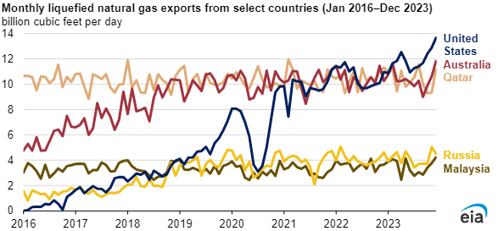
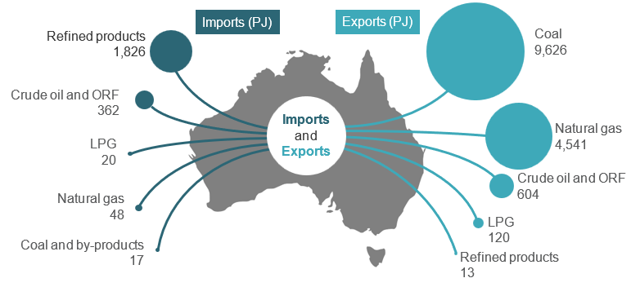
AUSTRALIA HAS A STRONG ENERGY MARKET WITH ROBUST & WORLD-CLASS COMMODITY PRICES
AUSTRALIAN ENERGY TRADE: 2022 - 2023
https://www.energy.gov.au/energy-data/australian-energy-statistics/energy-trade
OIL PRICE: $US BRENT BENCHMARK
HIGH EAST COAST GAS PRICES: Average daily ex ante gas prices quarter ending June 2025 over the Adelaide-Sydney-Brisbane gas hubs A$12.63/GJ
https://www.aer.gov.au/industry/registers/charts/sttm-quarterly-prices

Slide 7
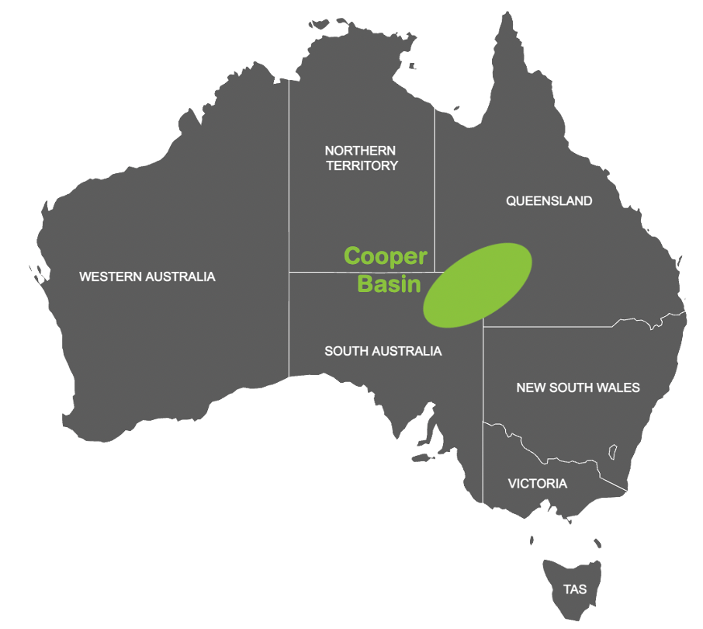
FOCUS ON INITIATING AND ENABLING ACTIVITIES
Management is focused on a number of high-impact projects.
All of these projects are targeted at effecting activities on 100% owned and operated assets.
COST-CUTTING MEASURES IMPLEMENTED
As press-released, Company has implemented significant G&A cost-reduction measures.
This resulted in being creative in identifying and working up accretive growth avenues.
STRATEGIC FARM-OUTS
To effect growth activities in this environment, focus is on targeted strategic farmouts based on previous work carried out by the Company, including drilling, 3D seismic, tests, identification of drilling upside opportunities, etc.
Objective is to avoid or minimize dilution, enable high-value activities with zero/low cost.
ACQUIRE TARGETED PRODUCTION OPPORTUNITIES
Management approached to evaluate production acquisition opportunities.
Technical, commercial, economic and value-creation assessment ongoing in Australia and other jurisdictions
NEW EXPERIENCED DIRECTOR ON THE GROUND
Neal Grant’s experience includes the Cooper Basin and onshore Australia in general.
Very interested in working with us, and will be extremely helpful in executing our strategy.
CURRENT STRATEGY
IN A LOW-COST ENVIRONMENT
Ashmore-Cartier Area

Slide 8
HIGH IMPACT OIL AND GAS PROJECTS
TOP-TIER JURISDICTION
Production, development and exploration assets in Australia’s Cooper Basin, Joint Venture ROFR exercise probable. Proximity to Asia provides significant advantage to supply developing markets.
HIGH GROWTH POTENTIAL
Strong mix of JV, 100%-owned cash generative assets and high-growth exploration assets that provides imminent growth opportunity with long term upside.
DEBT-FREE BALANCE SHEET
Debt-free balance sheet with positive operating cash flow providing coverage of corporate overhead costs.
EXPERIENCED AND DEDICATED MANAGEMENT
Management has substantial in-country oil and gas experience.
MANAGEMENT ALIGNED WITH SHAREHOLDERS
Management is highly aligned with their shareholders having committed their own capital.
IN AUSTRALIA’S COOPER BASIN
& OFFSHORE ASHMORE-CARTIER AREA
Ashmore-Cartier Area

Slide 9
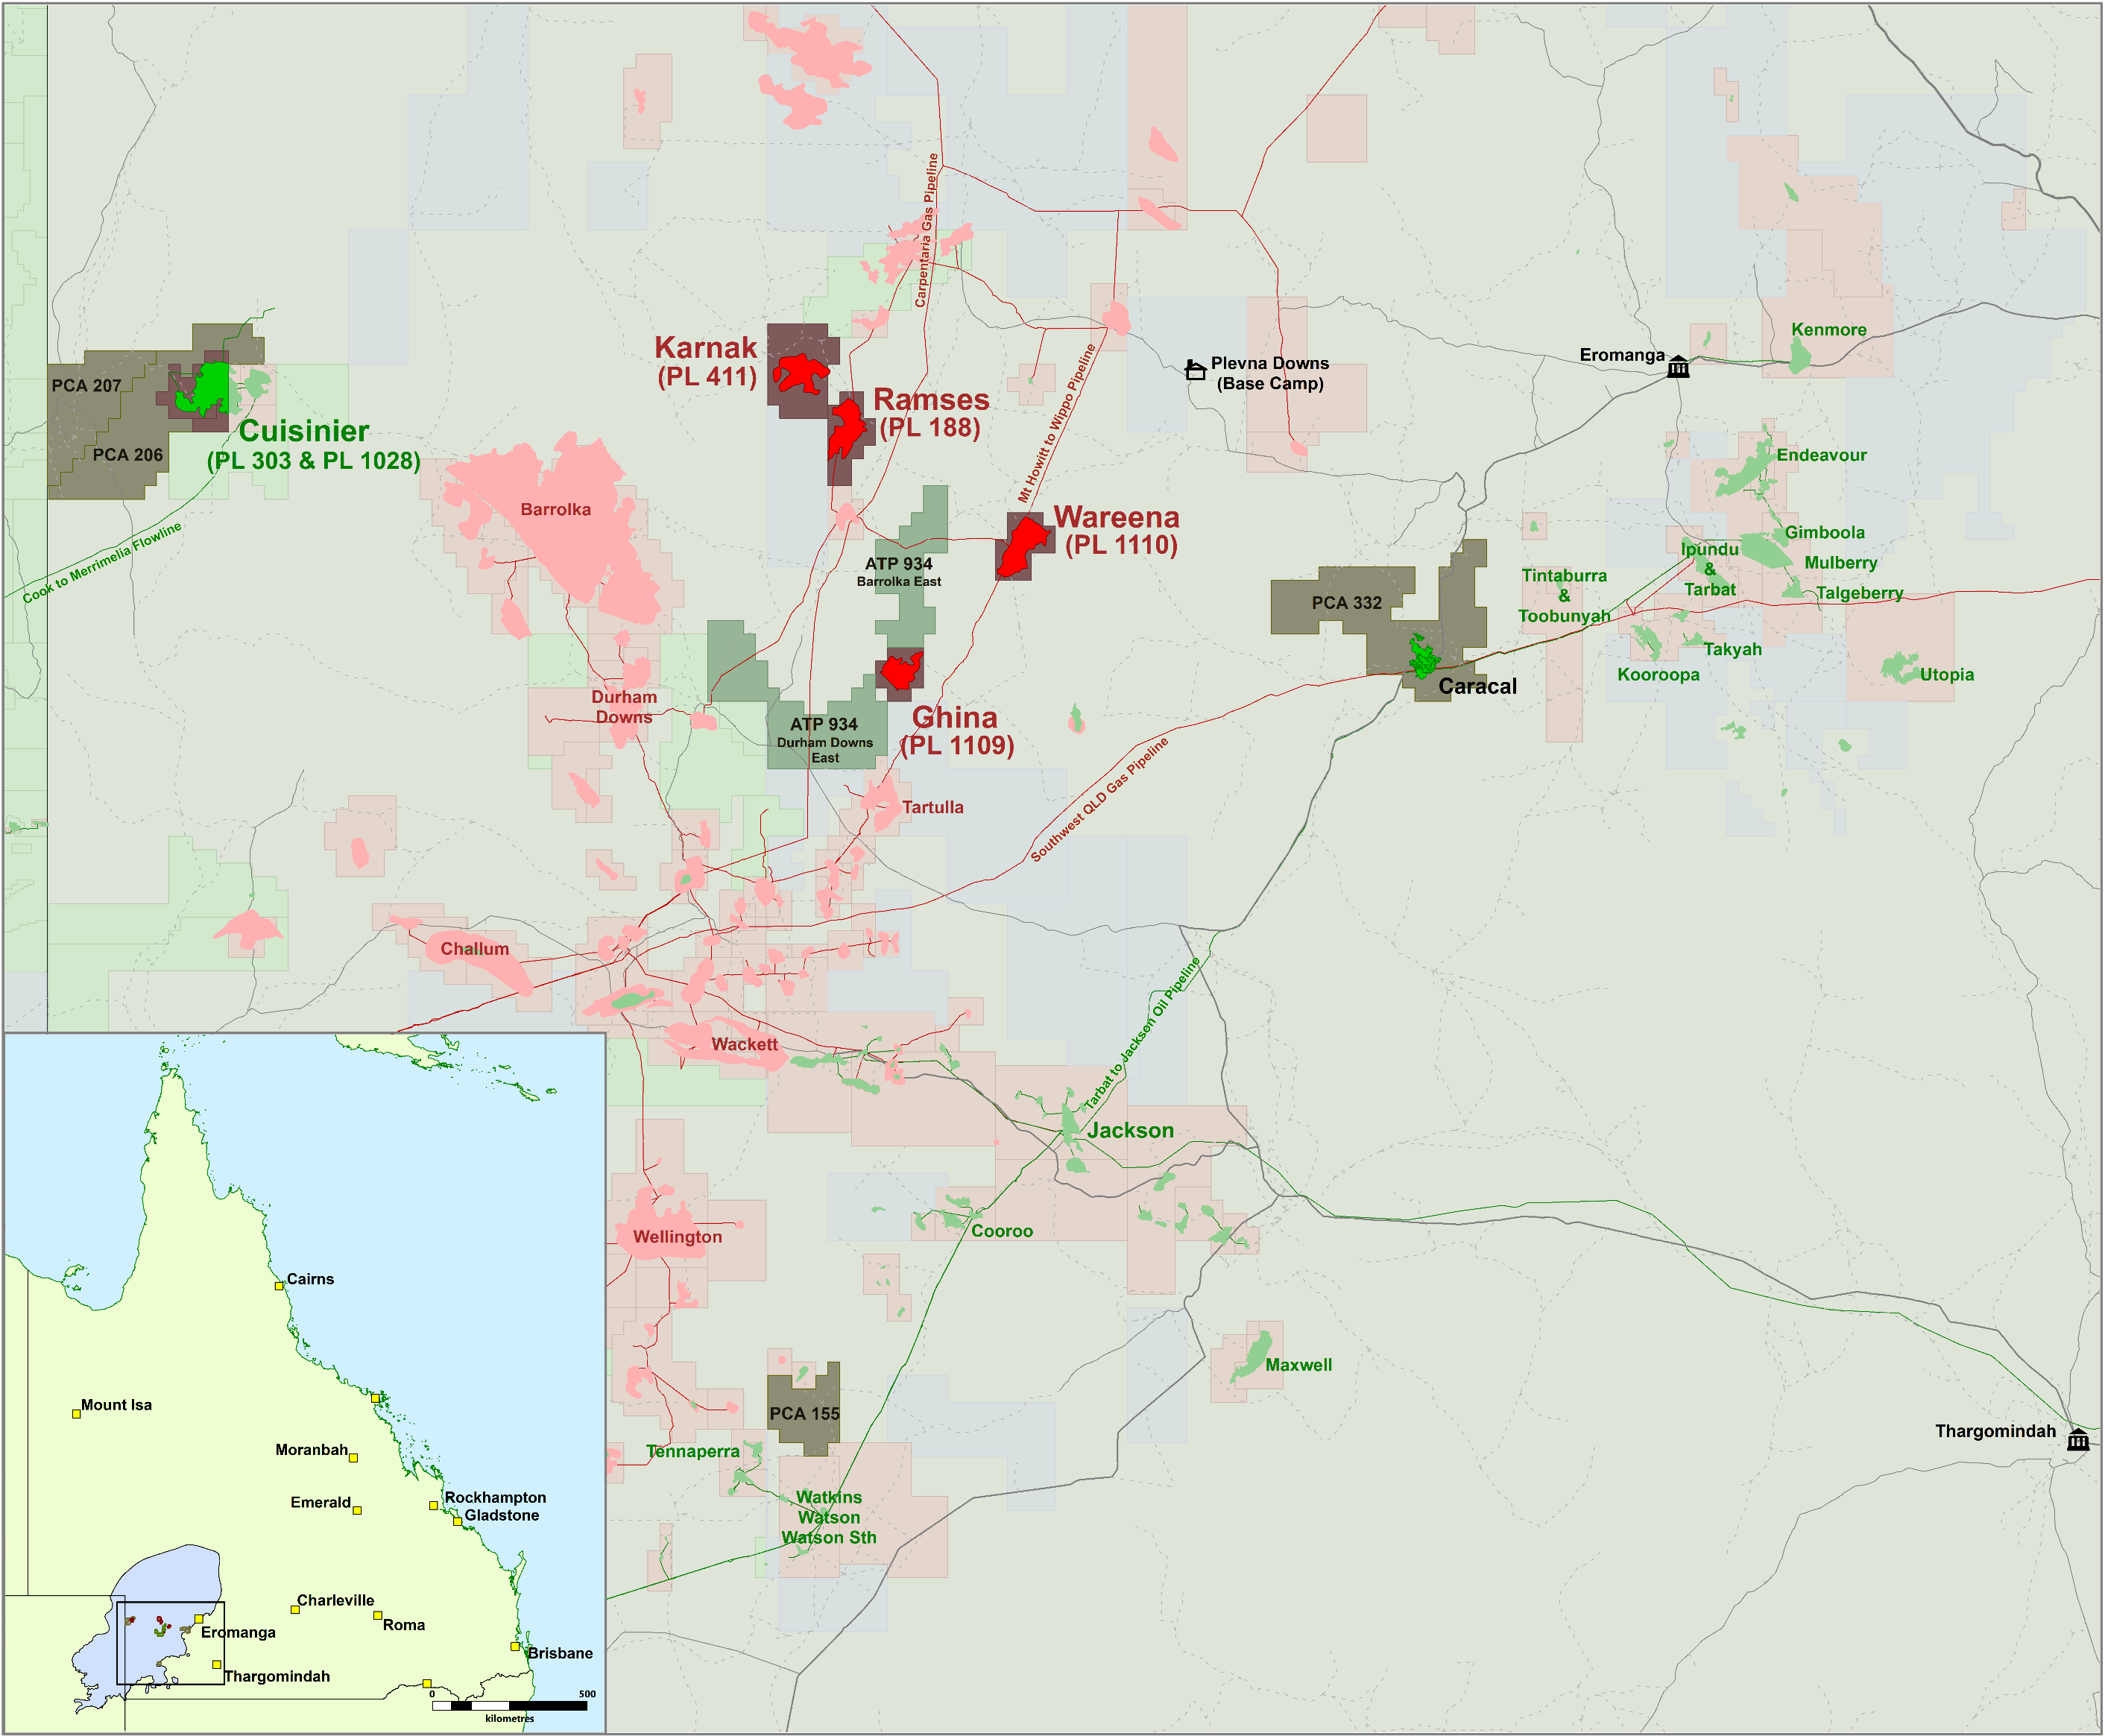
ACREAGE POSITION
Queensland’s Cooper Basin
Cuisinier 2P Reserves 5.78 MMbbls
PCA 332 TOOKOONOOKA – 100%
Cretaceous (e.g., Caracal-1 oil discovery) and Jurassic oil
Oil marketing possible through IOR Refinery, and Jackson Oil Terminal located nearby
Retention Licence granted in February 2023 for 15 years
CUISINIER – 30%
PL 303, PL 1028, PCA 206 & PCA 207
Multi well development drilling program planned post Field Development Plan update in future years
Water Flood expansion being planned possibly for 2026
FOUND HYDROCARBON FIELDS – 100%
Karnak – Permian gas find
Ramses – Permian gas and tested Jurassic oil
Ghina – Permian gas
Wareena – Permian gas (produced); with Gas Pipeline
ATP 934 BARROLKA – 40 - 100% BENGAL ENERGY
Permian gas plays
100% Barrolka East; 40% Durham Downs East (60% Santos)
Proximal to Bengal’s 100% owned Gas Pipeline

Slide 10
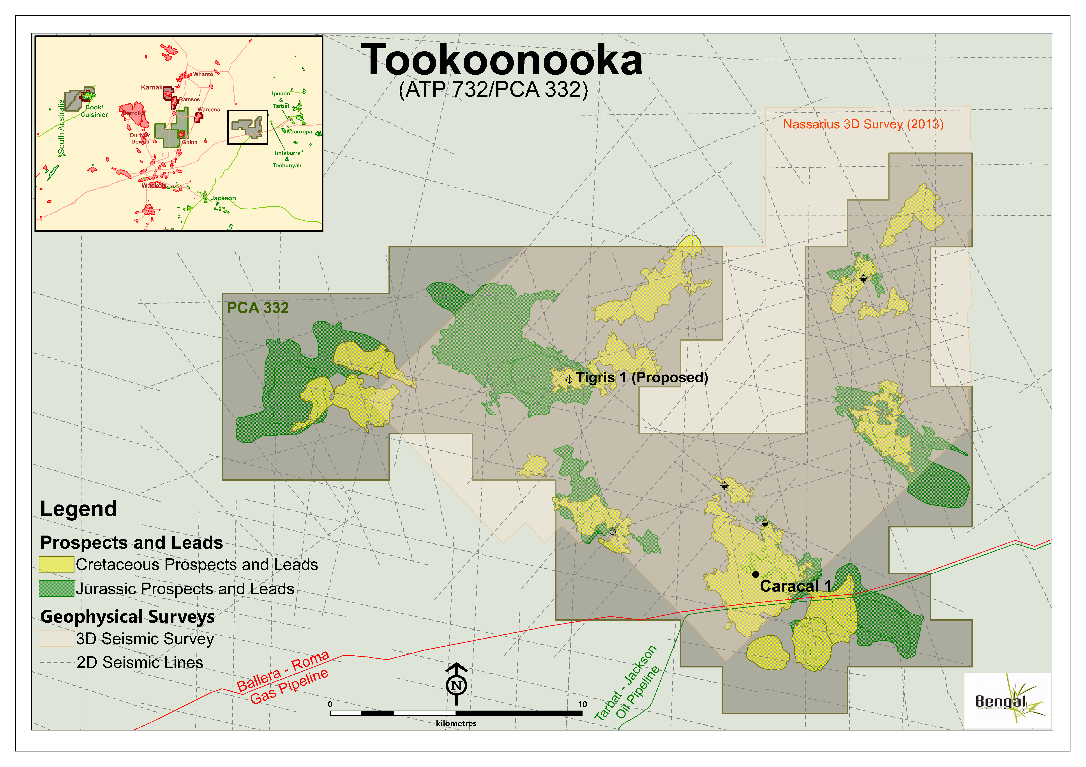
TOOKOONOOKA PROJECT – Permit PCA 332, 100% WI
SE Oil Province – Cooper Basin, Queensland
PROJECT DETAILS
PCA 332 (332 Km2) - lies within the SE Cooper oil province
Recoveries from adjacent fields range from 3 – 6 MMstb to date (still producing) *
Primary reservoirs: Hutton Sst, Birkhead Fm, and Wyandra Sst
IP Rates >1,500 bbls of oil per day *
Multiple untested 3D defined structures
PERMIT HIGHLIGHTS
Caracal 1 drilled in 2012 – Wyandra Sst oil discovery; in April 2022 yielded sustained oil to surface during clean-up from a tight reservoir
52º API oil with high diesel cut
Offtake agreement in place with nearby IOR Refinery
Independent resource report on Bengal acreage, March 30 2022
Drill-ready Tigris 1 location capable of testing multiple reservoir targets in the Tigris Exploration Prospect in a near-crestal position
Multiple offset locations on success case
Farmin Partners being sought
Tangalooma 1
* Source: https://www.data.qld.gov.au/dataset/petroleum-gas-production-and-reserve-statistics

Slide 11
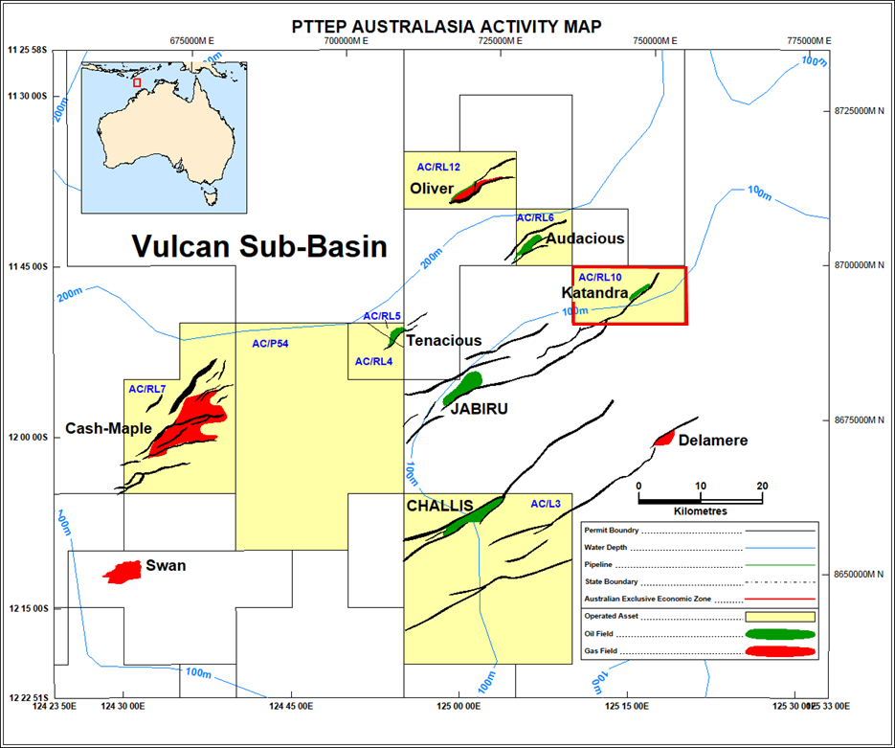
ACREAGE POSITION
Offshore Timor Sea
Permit AC/RL-10
Cuisinier 2P Reserves 5.78 MMbbls
Ashmore Cartier – Bonaparte Basin
Post PTTEP Withdrawal – Bengal Interest 100%
Oil Discovery at Katandra Well 2004
EUR estimate - Significant Prospectivity identified in the updip Katandra prospect
Awaiting NOPTA Renewal for a further 5-year term
Option - Binding Term Sheet
Binding Term Sheet in place subject to grant of extension
100% cost carry for Bengal through Option Term
If Option is exercised interest is Bengal 20%, Nuco 80%

Slide 12
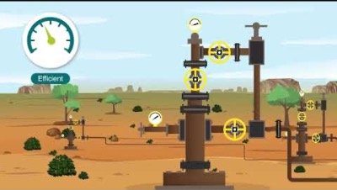
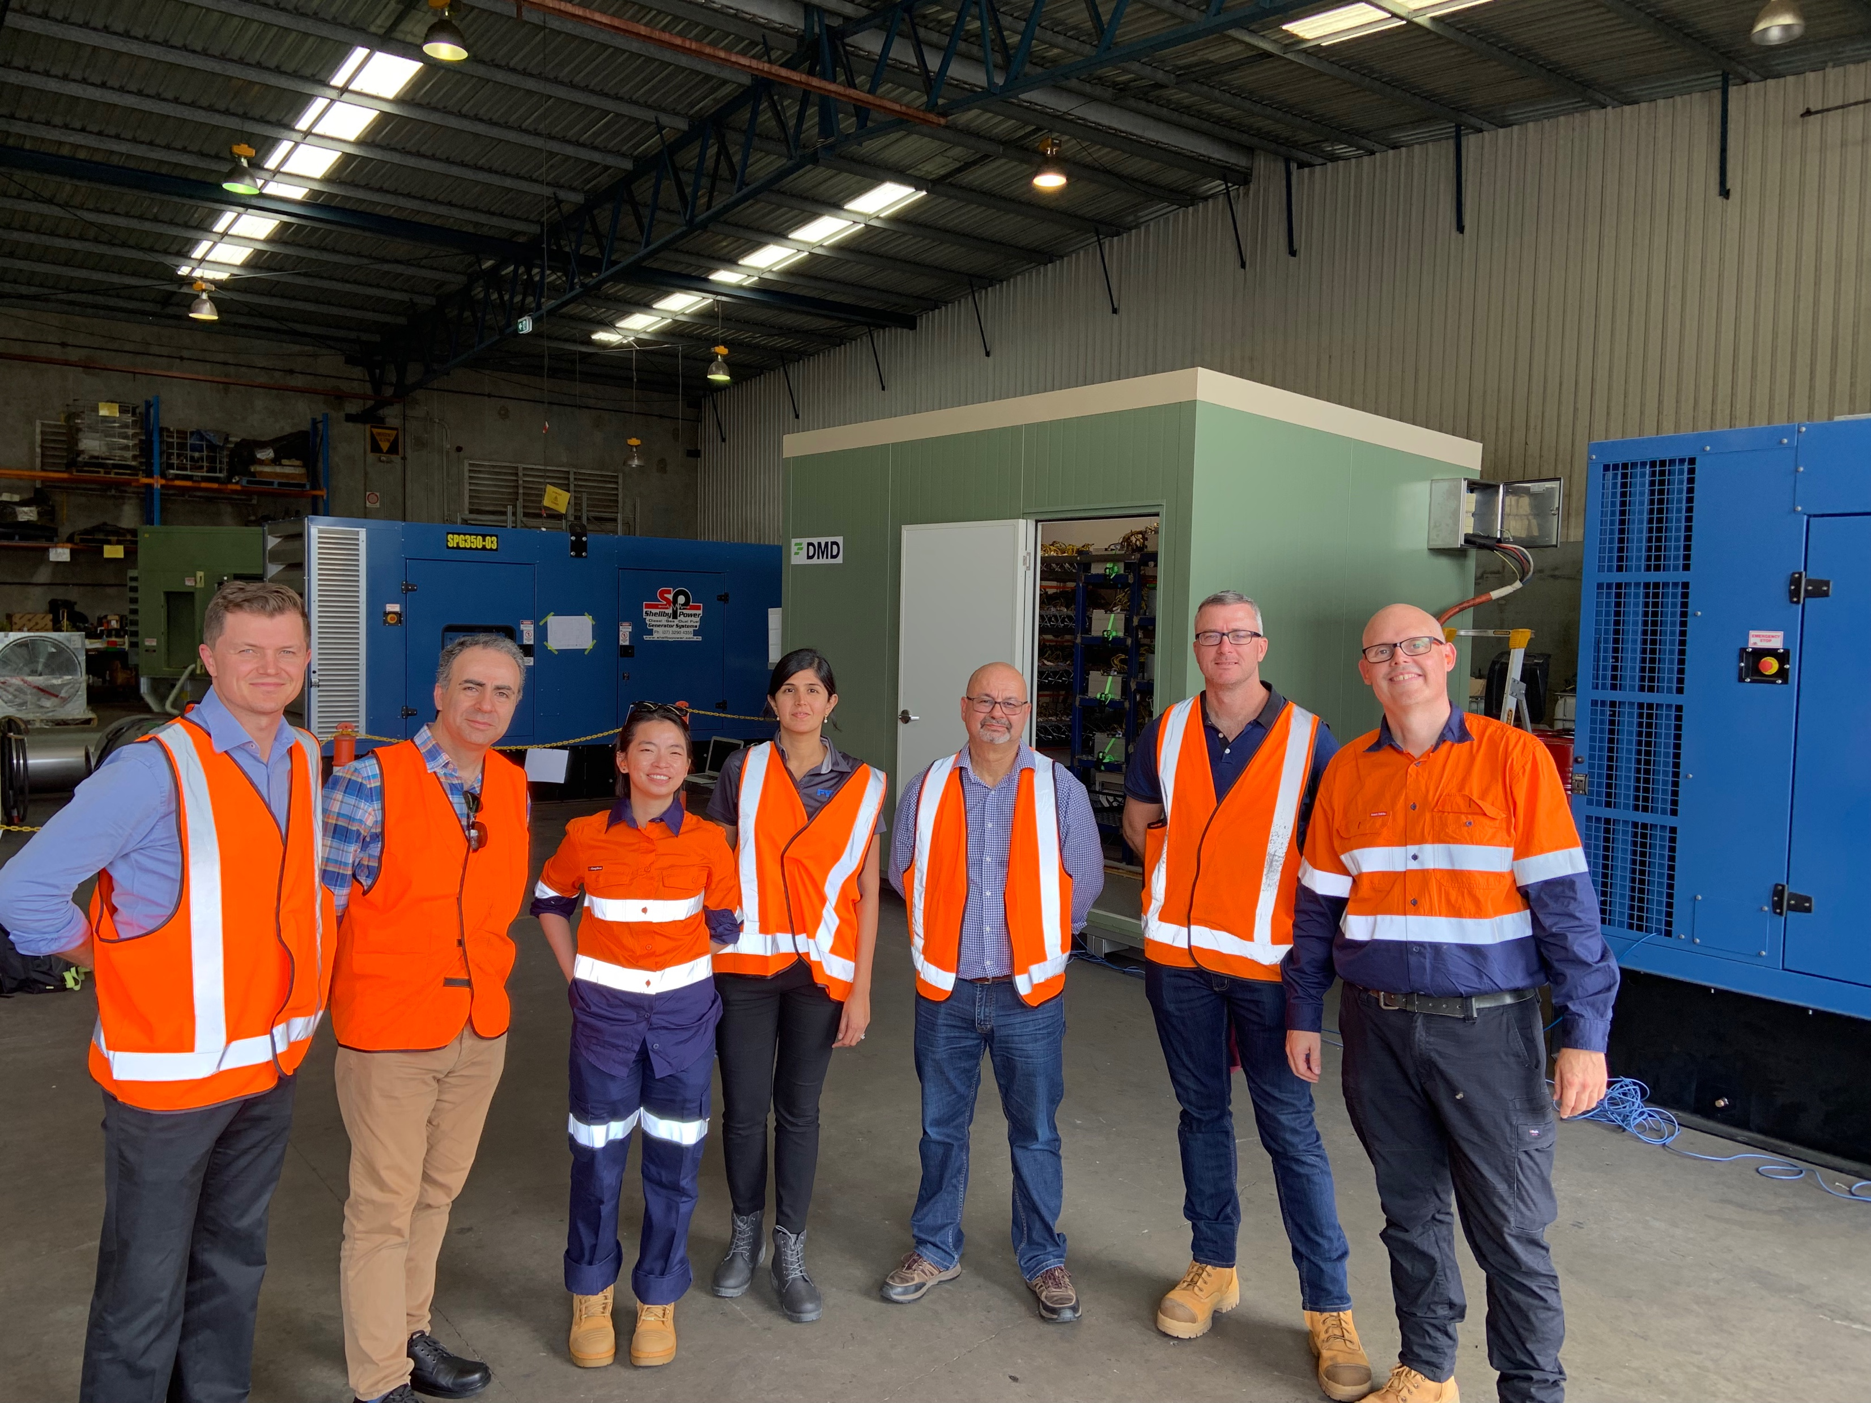
SUCCESSFUL TEST OF GAS TO BYTES STRATEGY Monetizing Stranded Gas Assets without the need for building extensive infrastructure
Demo plant
BENGAL SUCCESSFULLY DEMONSTRATED TECHNICAL FEASIBILITY OF MONETIZING STRANDED GAS TO BYTES THROUGH A PILOT IN THE QUEENSLAND OUTBACK: THE FIRST IN AUSTRALIA
Commercial 2 MWh pilot plant

Slide 13
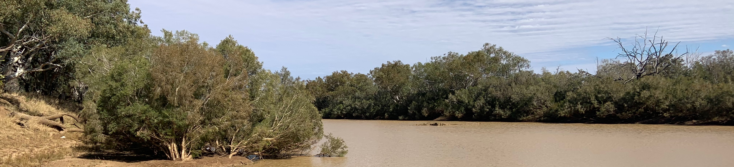




SUSTAINABLE DEVELOPMENT Bengal energy strives to be an active player of local communities and promote sustainable work practices
01
02
03
04
HEALTH AND
SAFETY
ENVIRONMENTAL STEWARDSHIP
SOCIAL RESPONSIBILITY
PEOPLE FIRST
Maximizing local employment opportunities
Equal opportunity employer
Promoting local supply chains
Health and safety is Bengal’s top priority.
The safety of our employees and contractors are put first
Targeting a low carbon footprint
Strong links with landholders and traditional owners
Integrating operations with local communities
Partnering with local community institutions
Working with traditional owners

Slide 14
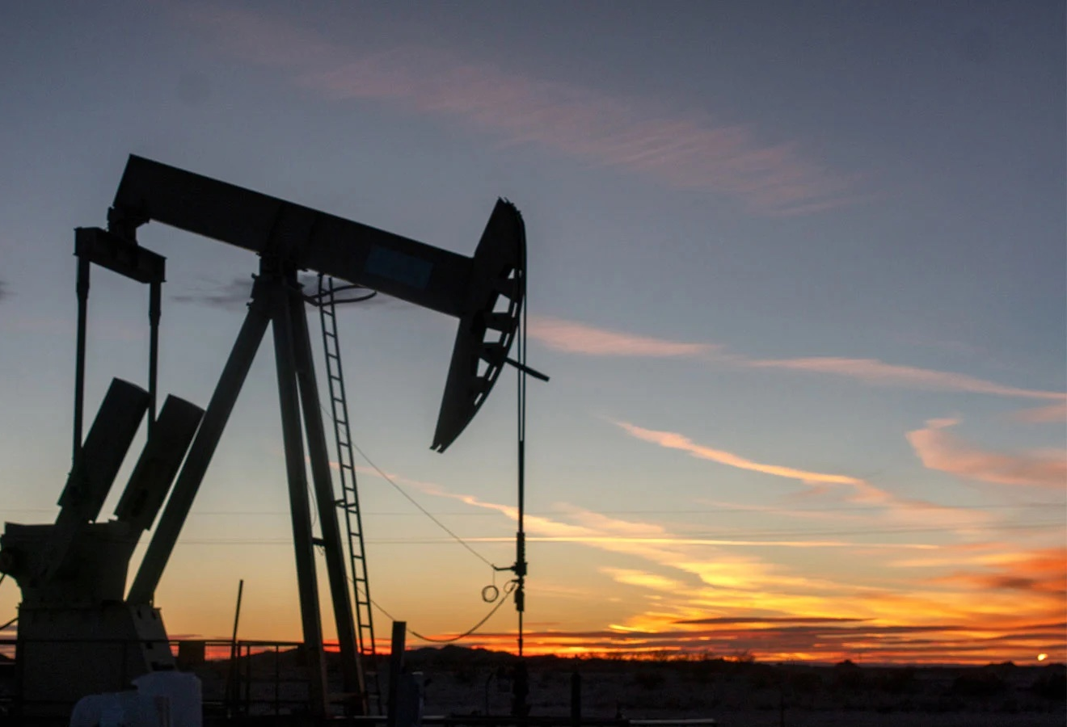
THANK
YOU
FOR MORE INFORMATION:
Suite 640 630 6th Ave S.W.
Calgary, AB, Canada, T2P 0S8
E: investor.relations@bengalenergy.ca
T: +1-403-205-2526
www.bengalenergy.ca
https://bengalenergy.ca/technology/early-gas-production-system
https://bengalenergy.ca/technology/early-oil-production-system/

